Slide 1

National Institute of Technology, Warangal Department of Management Studies
Desing Thimking Group -
Likhita, Dhritabrata, Padma, Prasanti, Satyaki, Kiranmayee

Slide 2
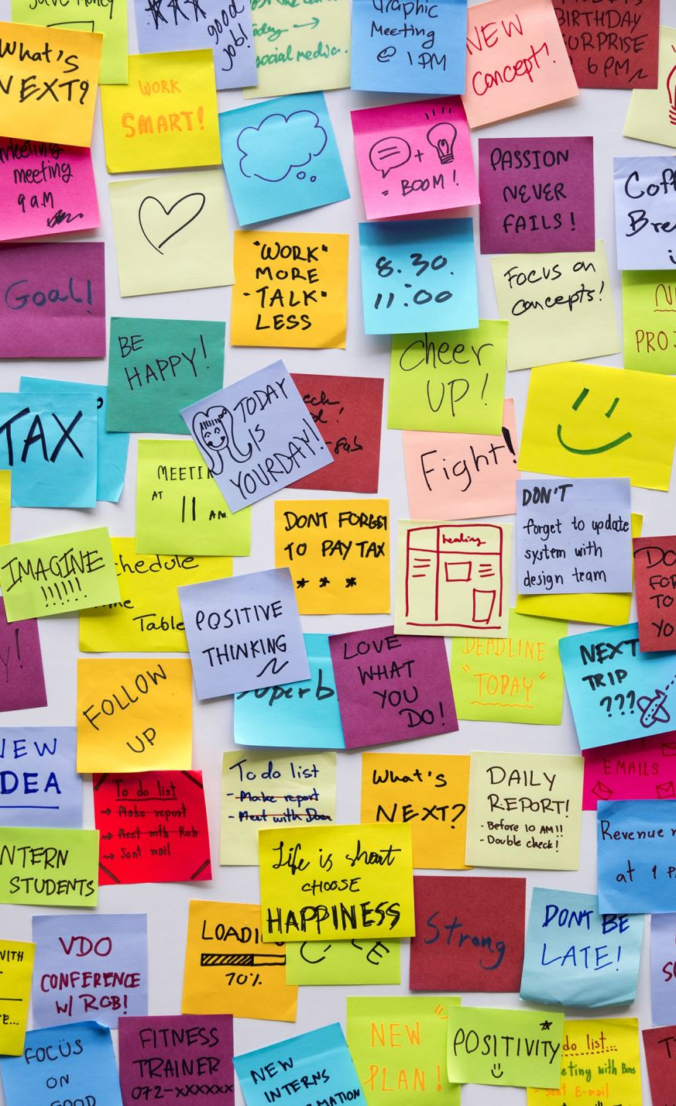
Design Thinking Approach to Hostel Mess Challenges
Empathize → Define → Ideate → Prototype → Test
Focus: Information Management System for Dynamic Mess Menu

Slide 3

Empathize - Understanding User Pain Points
Key Insights from Our Survey:
Students frustrated with water wastage and spillage
Hygiene concerns affecting meal experience
Diverse taste preferences not accommodated
Long queues and payment confusion
Food wastage due to poor demand estimation
User Emotions:
Dissatisfaction with current mess system
Desire for personalization and choice
Need for transparency and efficiency

Slide 4

Define - Problem Statement
Core Challenge: "How might we create a responsive mess management system that accommodates diverse student preferences while optimizing resource utilization and improving overall mess experience?"
Three Critical Problems Identified:
Water Management - Unregulated taps causing spillage
Hygiene Issues - Poor lighting and cleanliness standards
Menu & Time Inflexibility - One-size-fits-all approach, fails diverse tastes

Slide 5

Ideate - Solution Brainstorming
Problem 1: Water Spillage Solutions
Low Budget: Water-saving nozzles
Mid Budget: Push-tap mechanisms
High Budget: Automatic sensor taps

Slide 6
Problem 2 solutions: Hygiene Enhancement
Bright white LED lighting installation
Regular cleaning protocols
Pest control measures

Slide 7
Problem 3 solutions, part I: Takeaway Systems for breakfast & lunch
Grab-and-Go Packages: Banana, bread, boiled egg
Pre-packaged Options to eliminate morning rush
Lunch Takeaway option for busy students

Slide 8

Problem 3 solutions, part Ii : Dynamic Menu Management
Digital Solution: Mess Management App
Pre-order system with preference selection
Weekly billing for special items

Slide 9
Prototype Focus - Mess Management App
Why This Solution?
Optimizes resource utilization
Scalable to other hostel messes
Creates transparent communication

Slide 10
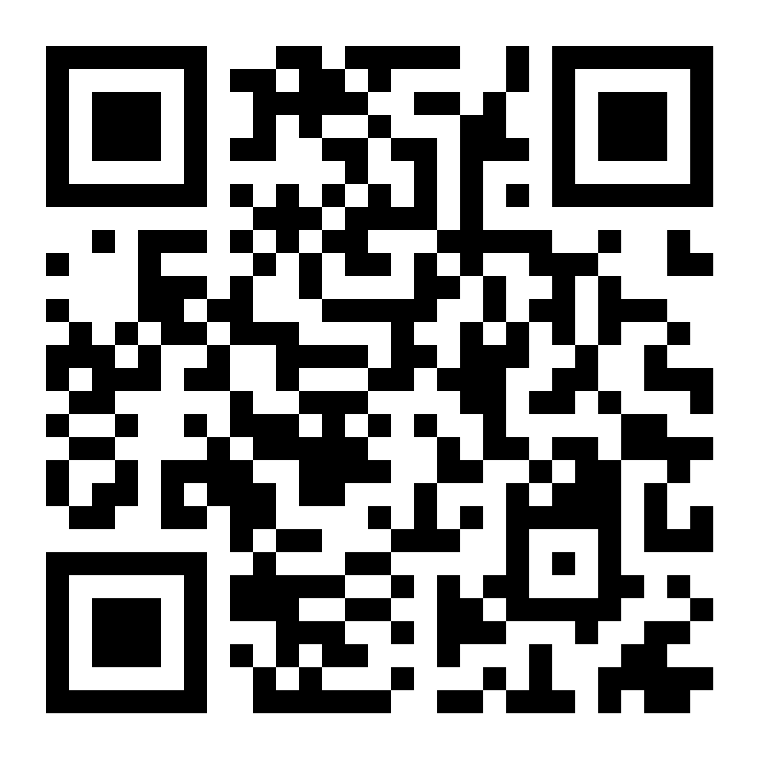
Prototype – NIT W mess management syestem
Core Features to Prototype:
Pre-booking System with advance payment
OTP-based Verification for meal collection
Time Slot Management to reduce queues
Real-time Inventory tracking for kitchen staff
Live Demo Available: https://pritam8abstract.github.io/nit-mess-system/

Slide 11
Prototype - System Architecture
Student Interface
Preference selection
Order tracking
Billing history
Administrative Panel
Usage analytics
Resource optimization
Financial tracking

Slide 12

PROTOTYPE - SYSTEM ARCHITECTURE
Student Portal (*.student.nitw.ac.in authentication)
Daily meal menu viewing
Non-veg advance booking with payment
OTP generation for meal collection
Time slot advance alertness (12:00-2:30 PM)
Manager Dashboard (@nitw.ac.in authentication)
OTP verification system
Student payment status checking
Daily demand analytics
Inventory planning tools
Takeaway System Integration
Breakfast package pre-ordering
Lunch takeaway options

Slide 13

Expected Outcomes
Resource Optimization:
Reduced food wastage through accurate demand prediction
Better inventory management
Cost savings for mess operations
User Experience Enhancement:
100% Meal Availability for paid bookings
Convenient Breakfast takeaway options
Transparent payment and booking system
Scalability Potential:
Data-driven insights for menu planning
Community feedback integration

Slide 14

Thank you,
Any Questions ?

